Slide 1
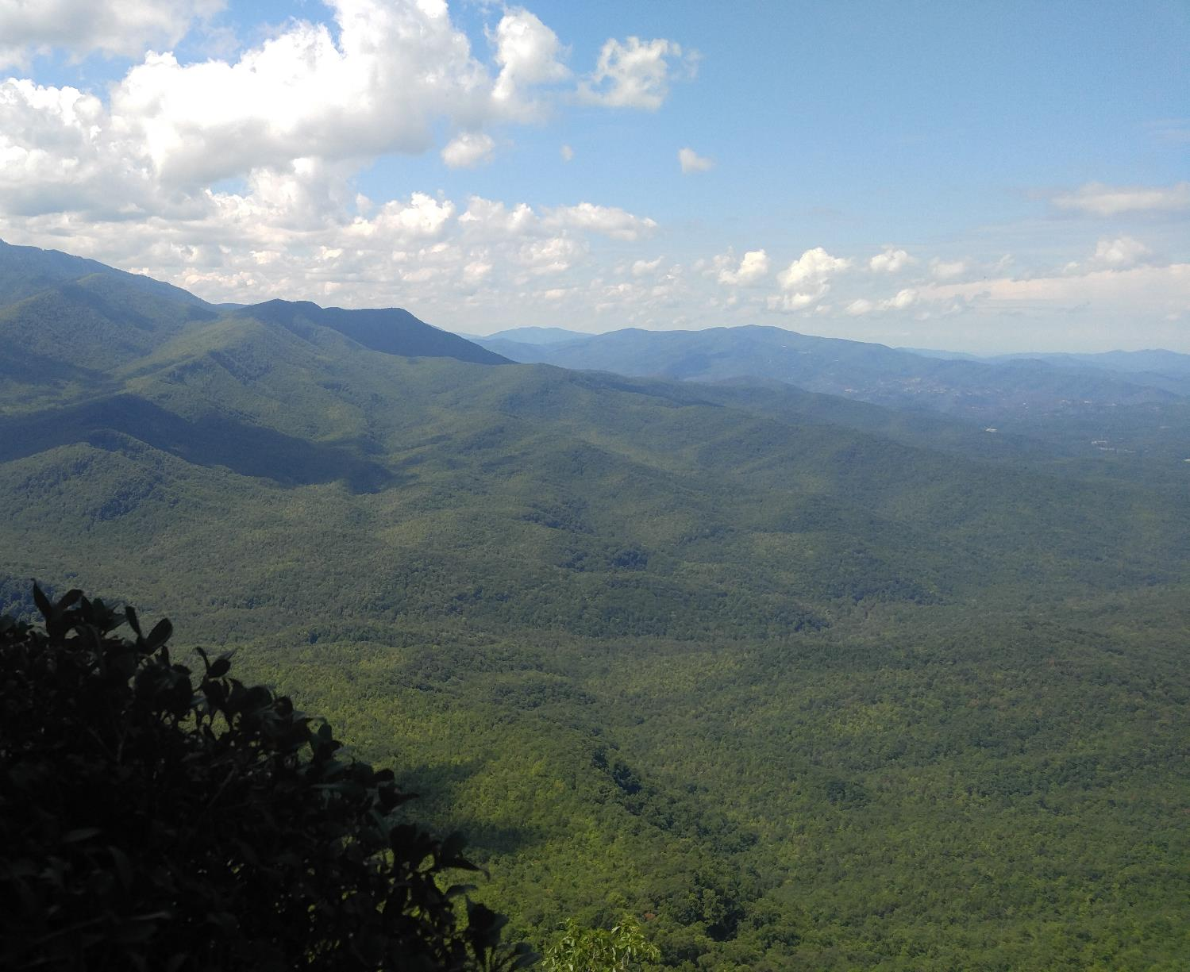
The Power of Plants!

Slide 2
Learning Objectives
Set up an experiment with two variables.
Make observations and record time variable data.
Create a graph from recorded data.
Interpret data and draw conclusions from an experiment.

Slide 3
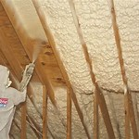
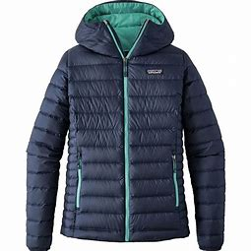
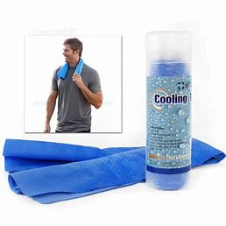
What do all these things have in common?
Your Home’s Insulation
A Down Jacket
A Cooling Towel
Regulates Temperature

Slide 4
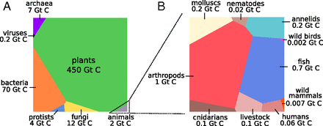
Analogy: Down Jacket is to Your Body as ______ is to Earth?
Bar-On, Phillips, and Milo (2018)

Slide 5
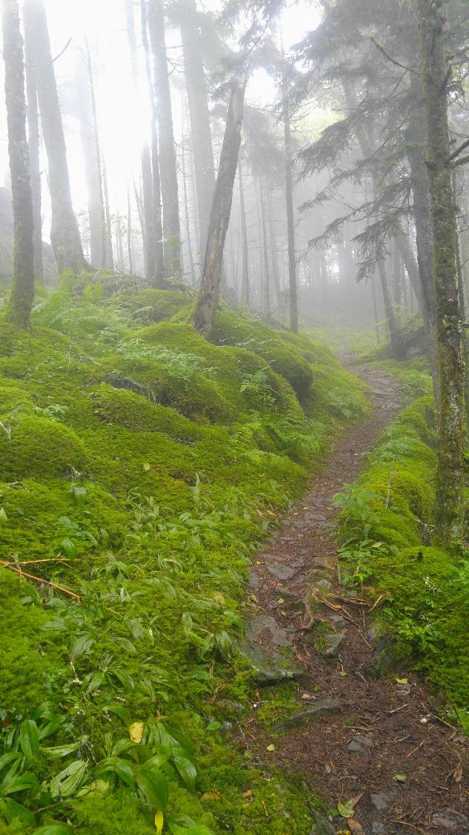
Plants Can Control Local Weather
Take up and vaporize water
Control local humidity and temperature
Low albedo (reflection of solar energy); absorbs energy
Evaporative cooling from transpiration

Slide 6
Materials
4 deep foil pie tins or shoe boxes
4 digital thermometers with max and min recording capabilities
Small shovel and bucket
Local soil
Mulch
Water
Measuring cup
Scale (optional)
Ruler
Layout of schoolyard with directional North and South
Pen and paper
Masking tape

Slide 7
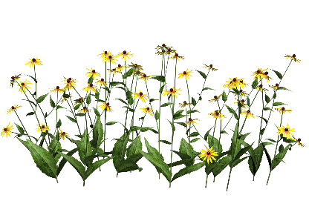
Experimental Layout
Temperature
 | North Side (Shade) | South Side (Sun, Warming Influence)
Bare Soil | NB | SB
Mulch Cover (Biomass Influence) | NM | SM
Land Cover

Slide 8
 | North Side |  |  |  |  |  | South Side
 | Bare |  |  | Mulch |  |  | Bare |  |  | Mulch
Day | Low | High | Variation | Low | High | Variation | Low | High | Variation | Low | High | Variation
1
2
3
4
5
6
7
Avg:
Variation = High Temperature – Low Temperature

