Slide 1
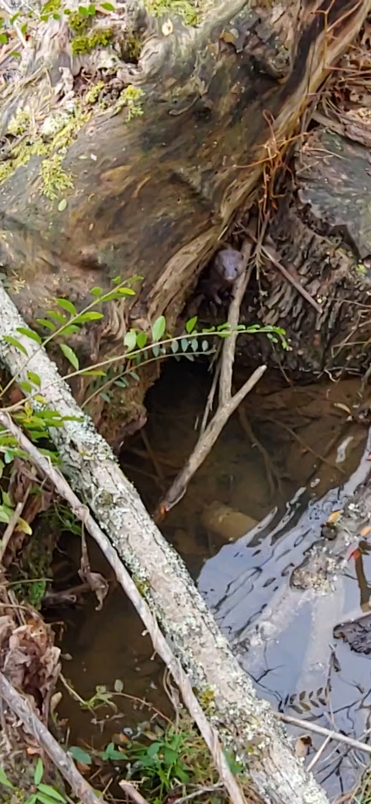
Biodiversity from Sea to Shining Sea
Andrea Ludwig, PhD, EIT
Associate Professor of Ecological Engineering & Extension Specialist

Slide 2
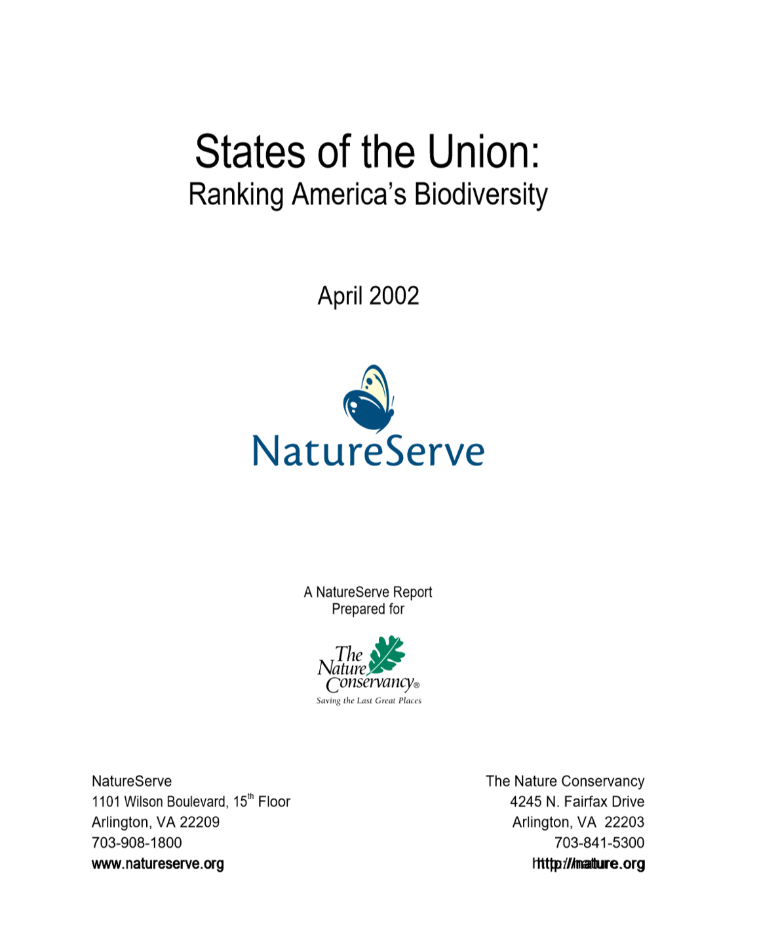
https://www.natureserve.org/sites/default/files/publications/files/stateofunions.pdf

Slide 3
Objectives
Define biodiversity and describe influencers.
Relate quantitative spatial data.
Use ranking to determine an answer.

Slide 4
Biodiversity Influencers
Positive
Ecosystem Diversity
Climate Diversity
Negative
Human Impacts
Land Conversion
Species Richness
Pollution
Invasive Species
Topography Variation

Slide 5
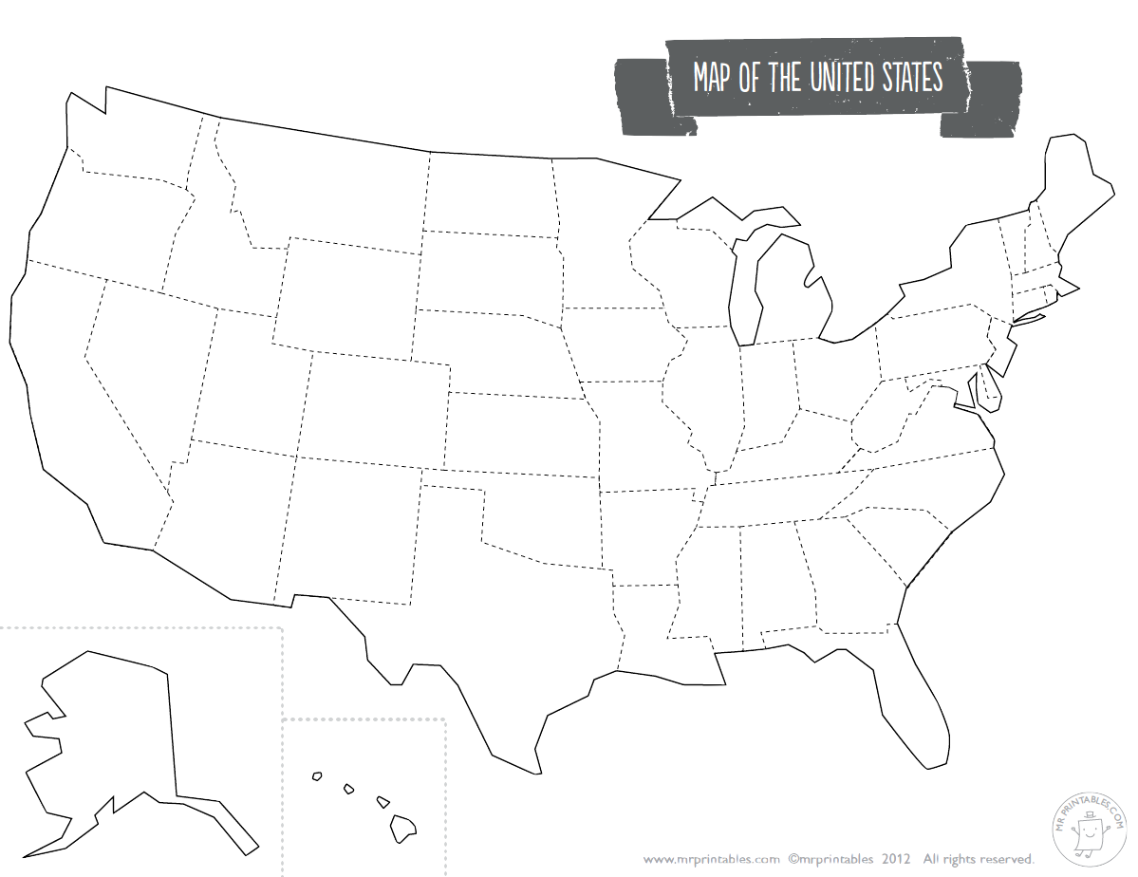
The United States of America
Where is the highest biodiversity?

Slide 6
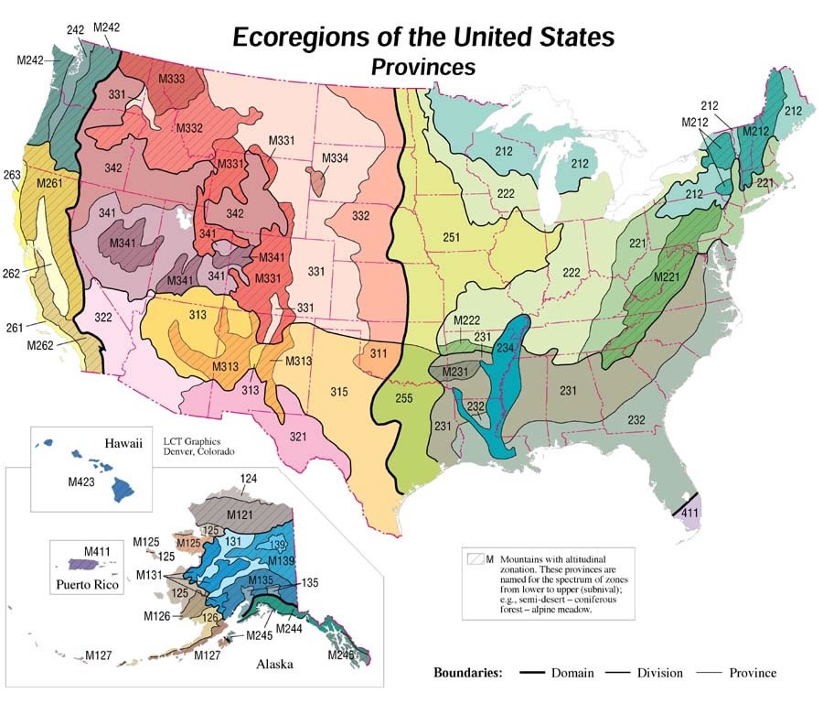
https://www.fs.fed.us/rm/ecoregions/products/map-ecoregions-united-states/#

Slide 7
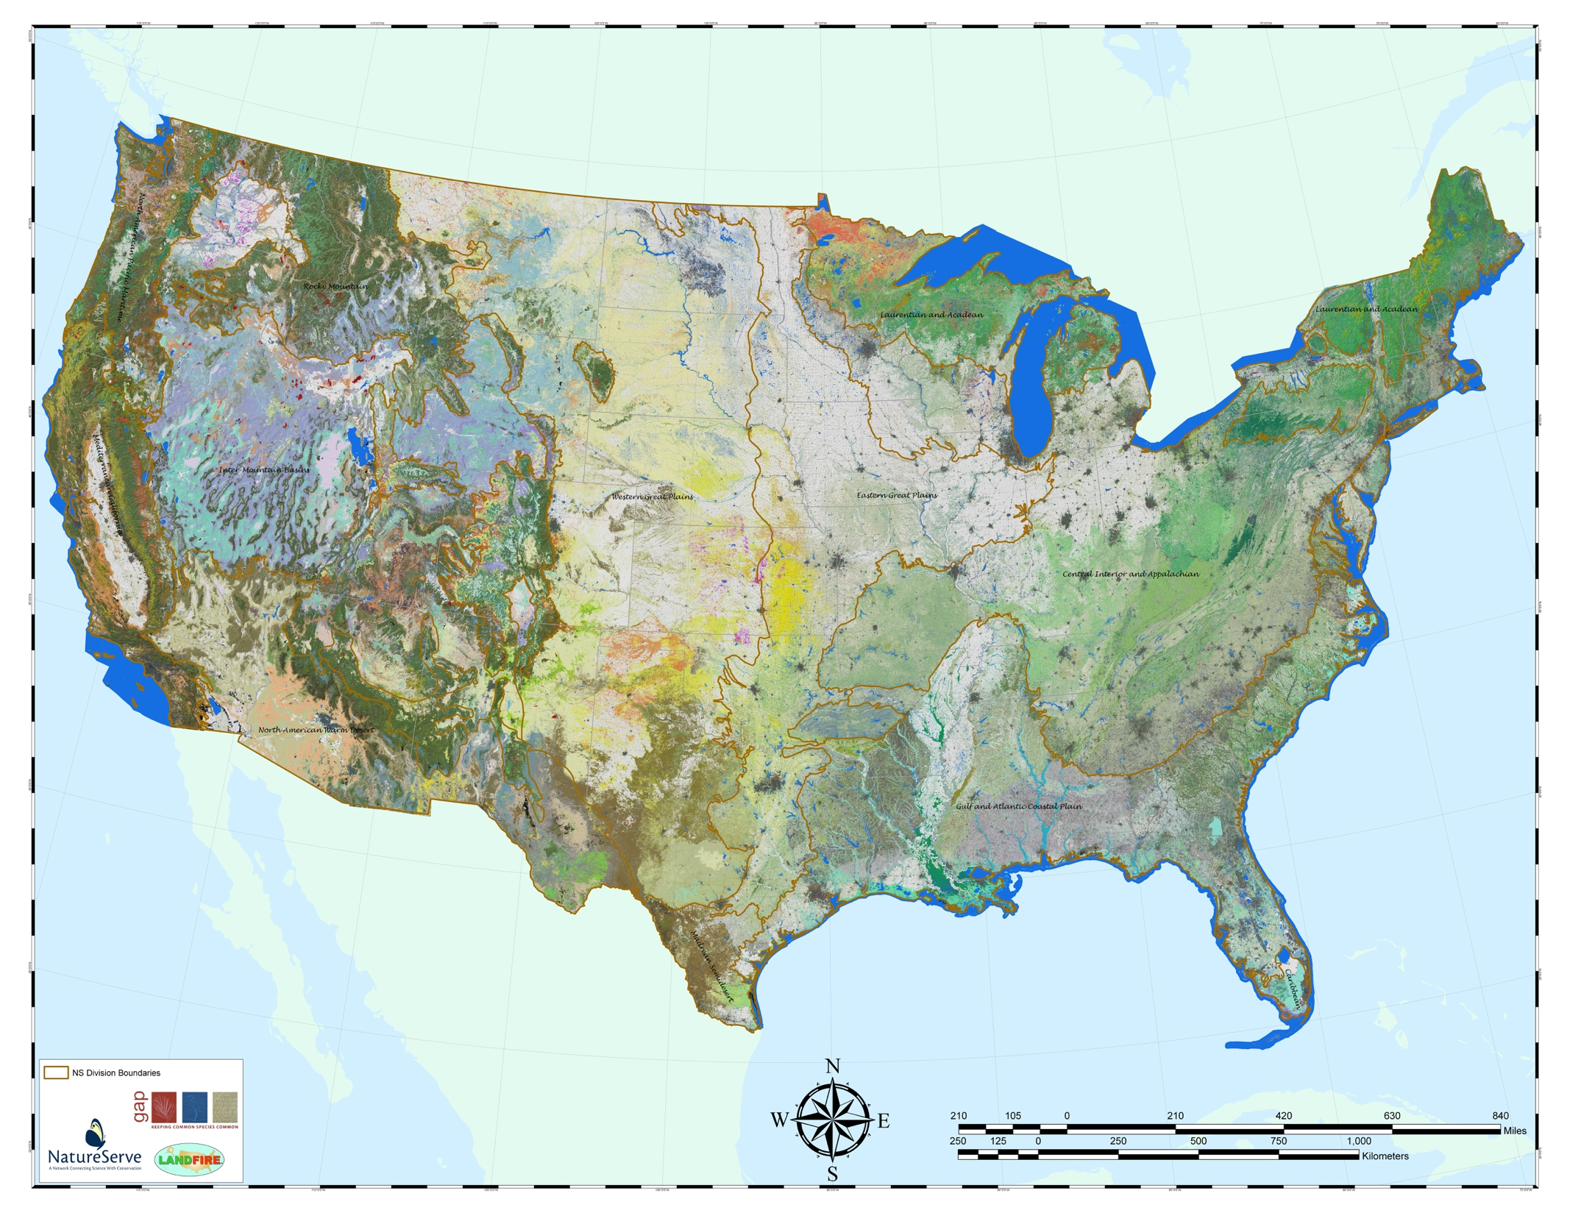
Terrestrial Ecosystems

Slide 8
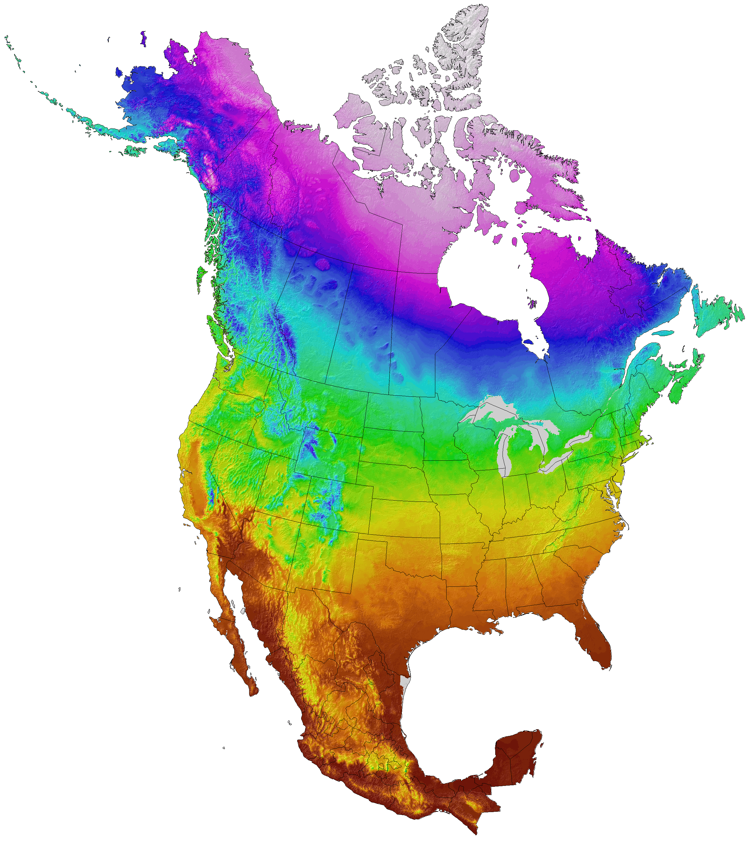
Average Annual Temperature

Slide 9
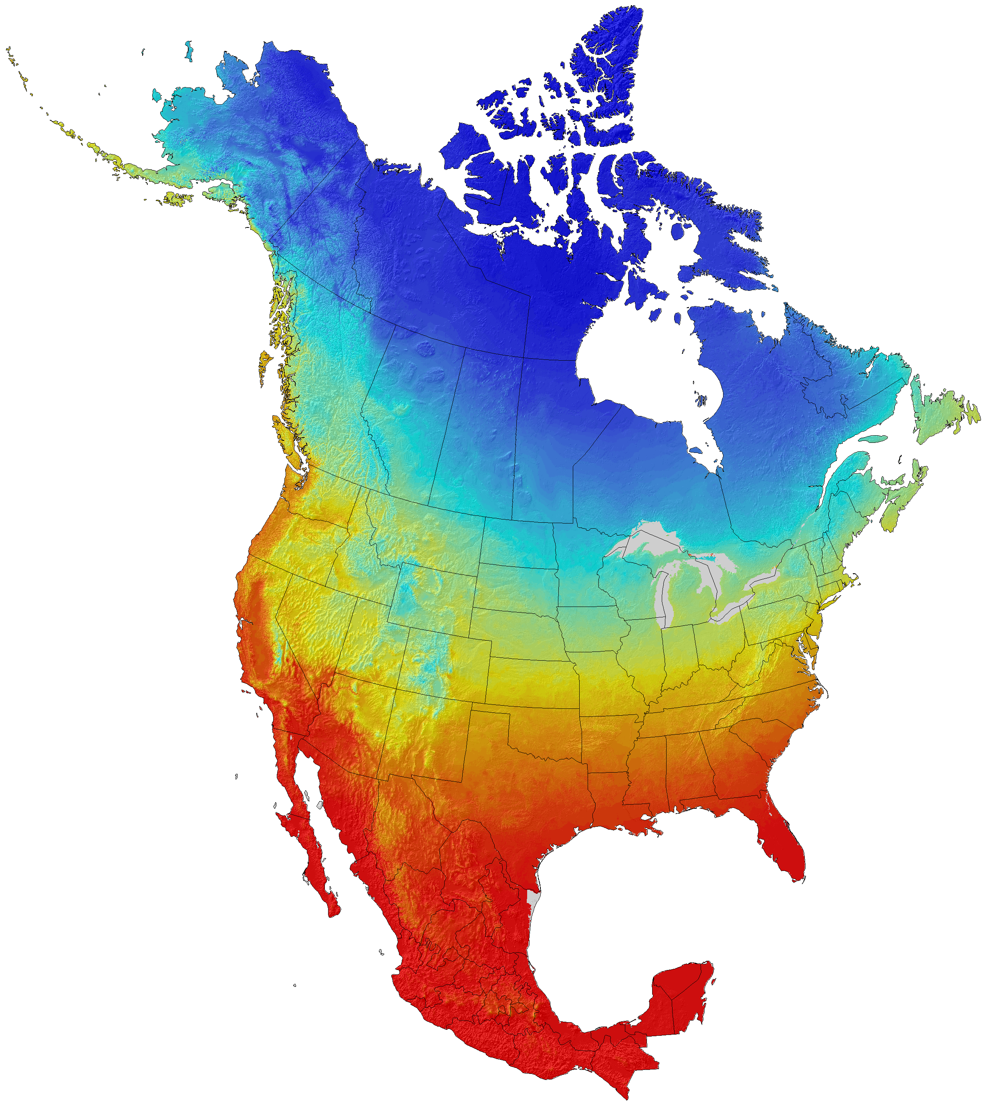
Average Winter Temperature

Slide 10
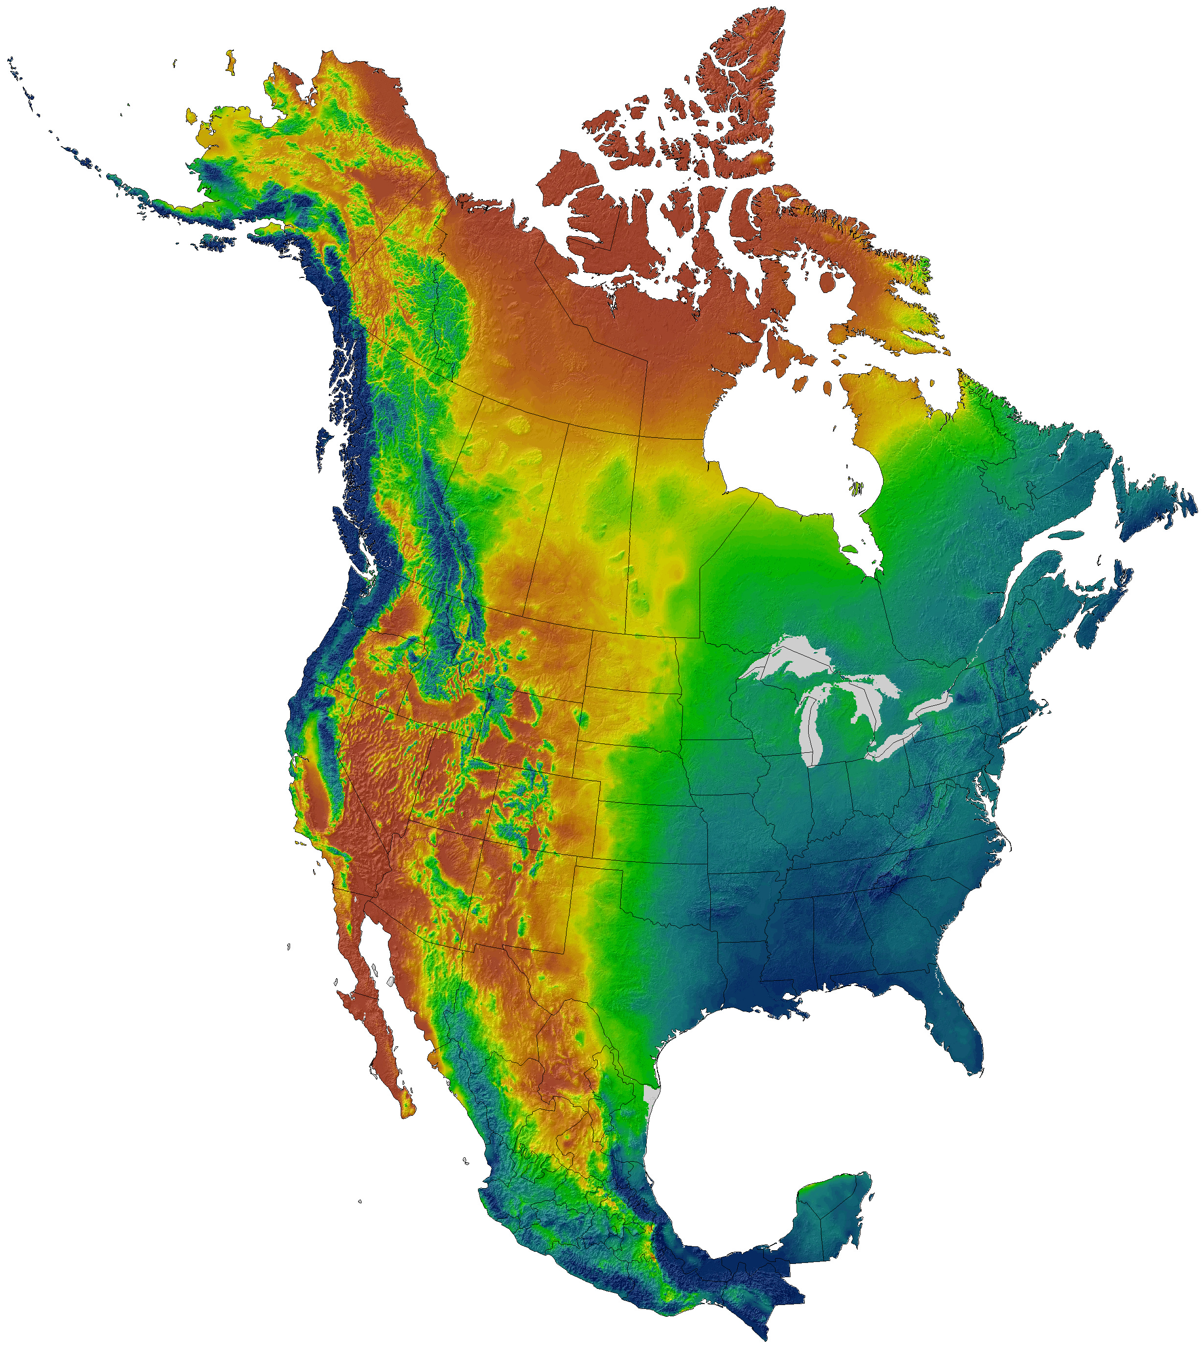
Average Annual Rainfall

Slide 11
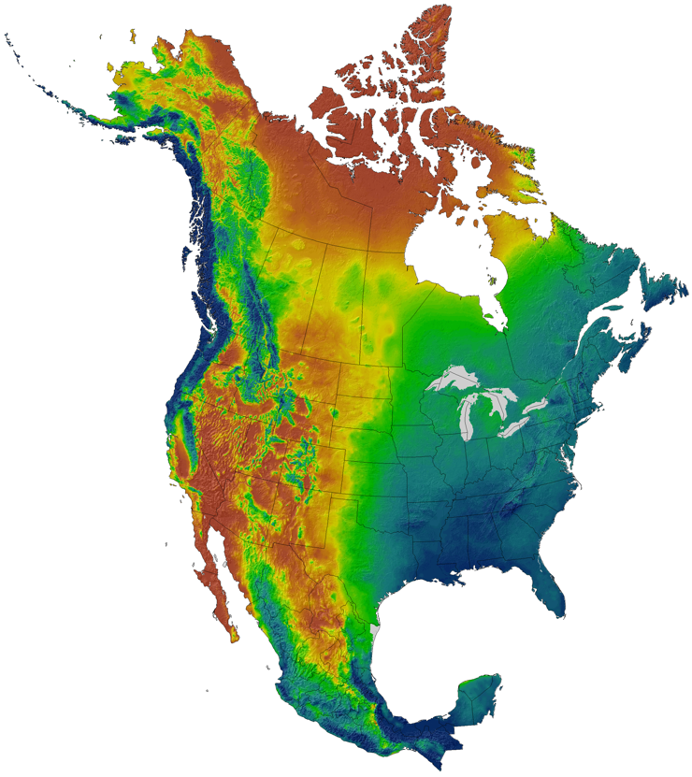
Climate Diversity
Average Annual Temperature
Average Winter Temperature
Average Annual Rainfall
https://adaptwest.databasin.org/pages/adaptwest-climatena

Slide 12
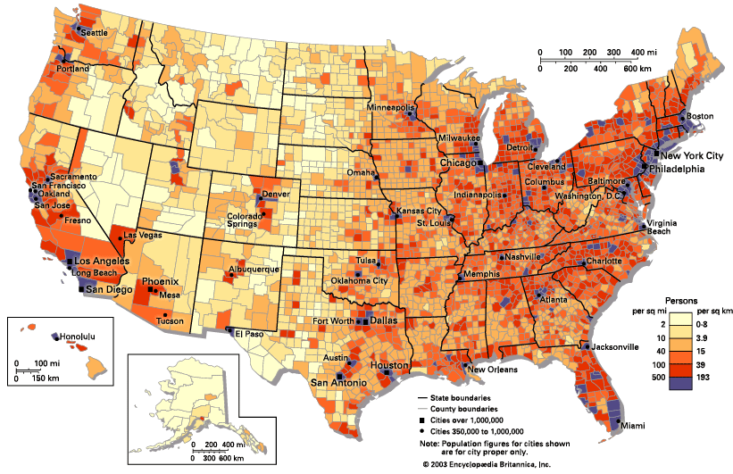
https://kids.britannica.com/students/assembly/view/65679

Slide 13
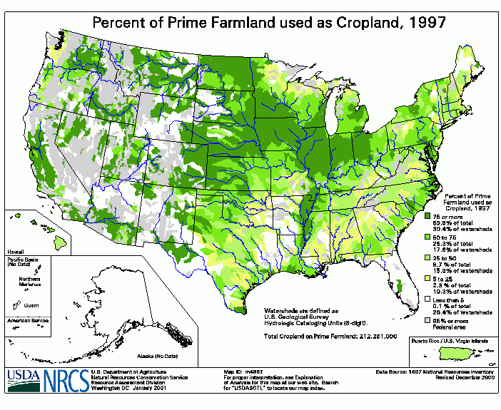
https://www.nrcs.usda.gov/wps/portal/nrcs/detail/national/technical/?cid=nrcs143_013738

Slide 14
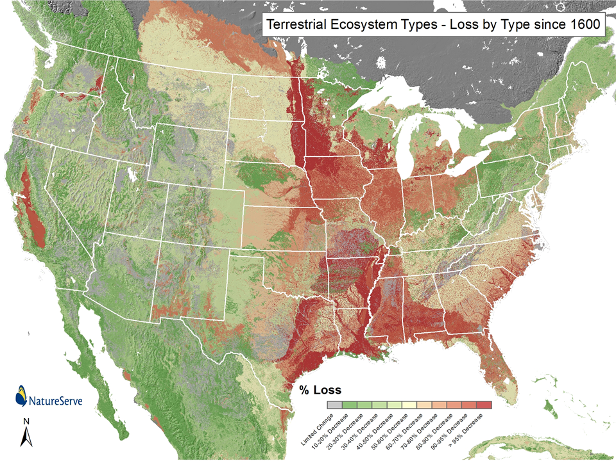

Slide 15
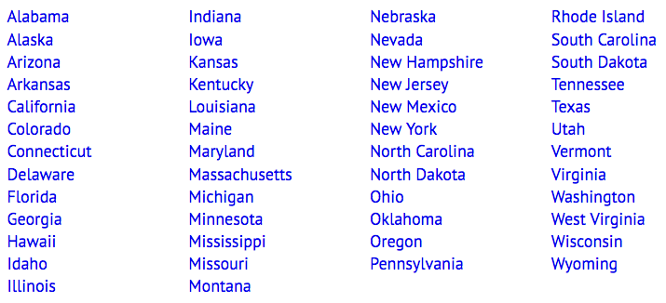
Biodiversity from Sea to Shining Sea
Based on the observations, what do you hypothesize are the top 5 most diverse states?
__________________
__________________
__________________
__________________
__________________
Based on the activity, what are the top five states with the greatest biodiversity?
_________________
_________________
_________________
_________________
_________________
The 50 States:
Q1: What are some causes of biodiversity loss?
_______________________
_______________________
Q2: What can be done to protect biodiversity?
_______________________
_______________________

Slide 16
United States of America
Species Diversity by State¹
3,375
2,921
1,889
2,327
2,352
4,136
2,817
2,274
3,205
2,406
2,869
3,333
2,765
3,184
3,135
2,497
3,022
2,078
2,587
2,533
3,135
3,872
3,152
3,148
3,098
3,892
3,258
2,244
6,717
3,597
2,778
2,873
3,340
3,258
3,803
3,772
4,131
4,759
3,616
3,415
3,701
4,583
3,580
4,533
4,436
6,273
3,495
1,835
4,368
1,418
¹ Bruce A. Stein. 2002. States of the Union: Ranking America’s Biodiversity. Arlington, Virginia: NatureServe.

Slide 17
https://kids.britannica.com/students/assembly/view/65679

Slide 18
United States of America
Species Diversity by State¹
3,375
2,921
1,889
2,327
2,352
4,136
2,817
2,274
3,205
2,406
2,869
3,333
2,765
3,184
3,135
2,497
3,022
2,078
2,587
2,533
3,135
3,872
3,152
3,148
3,098
3,892
3,258
2,244
6,717
3,597
2,778
2,873
3,340
3,258
3,803
3,772
4,131
4,759
>5,501
4,501-5,500
3,701-4,500
3,001-3,701
2,201-3,000
<2,200
4,583
3,616
3,415
3,701
3,580
4,533
4,436
6,273
3,495
1,835
4,368
1,418
¹ Bruce A. Stein. 2002. States of the Union: Ranking America’s Biodiversity. Arlington, Virginia: NatureServe.

Slide 19
Label states with names.
Create heat map of biodiversity using color scale given.
Use color pencils on handout to create heat map to take.
>5,501
4,501-5,500
3,701-4,500
3,001-3,700
2,201-3,000
<2,200

Slide 20
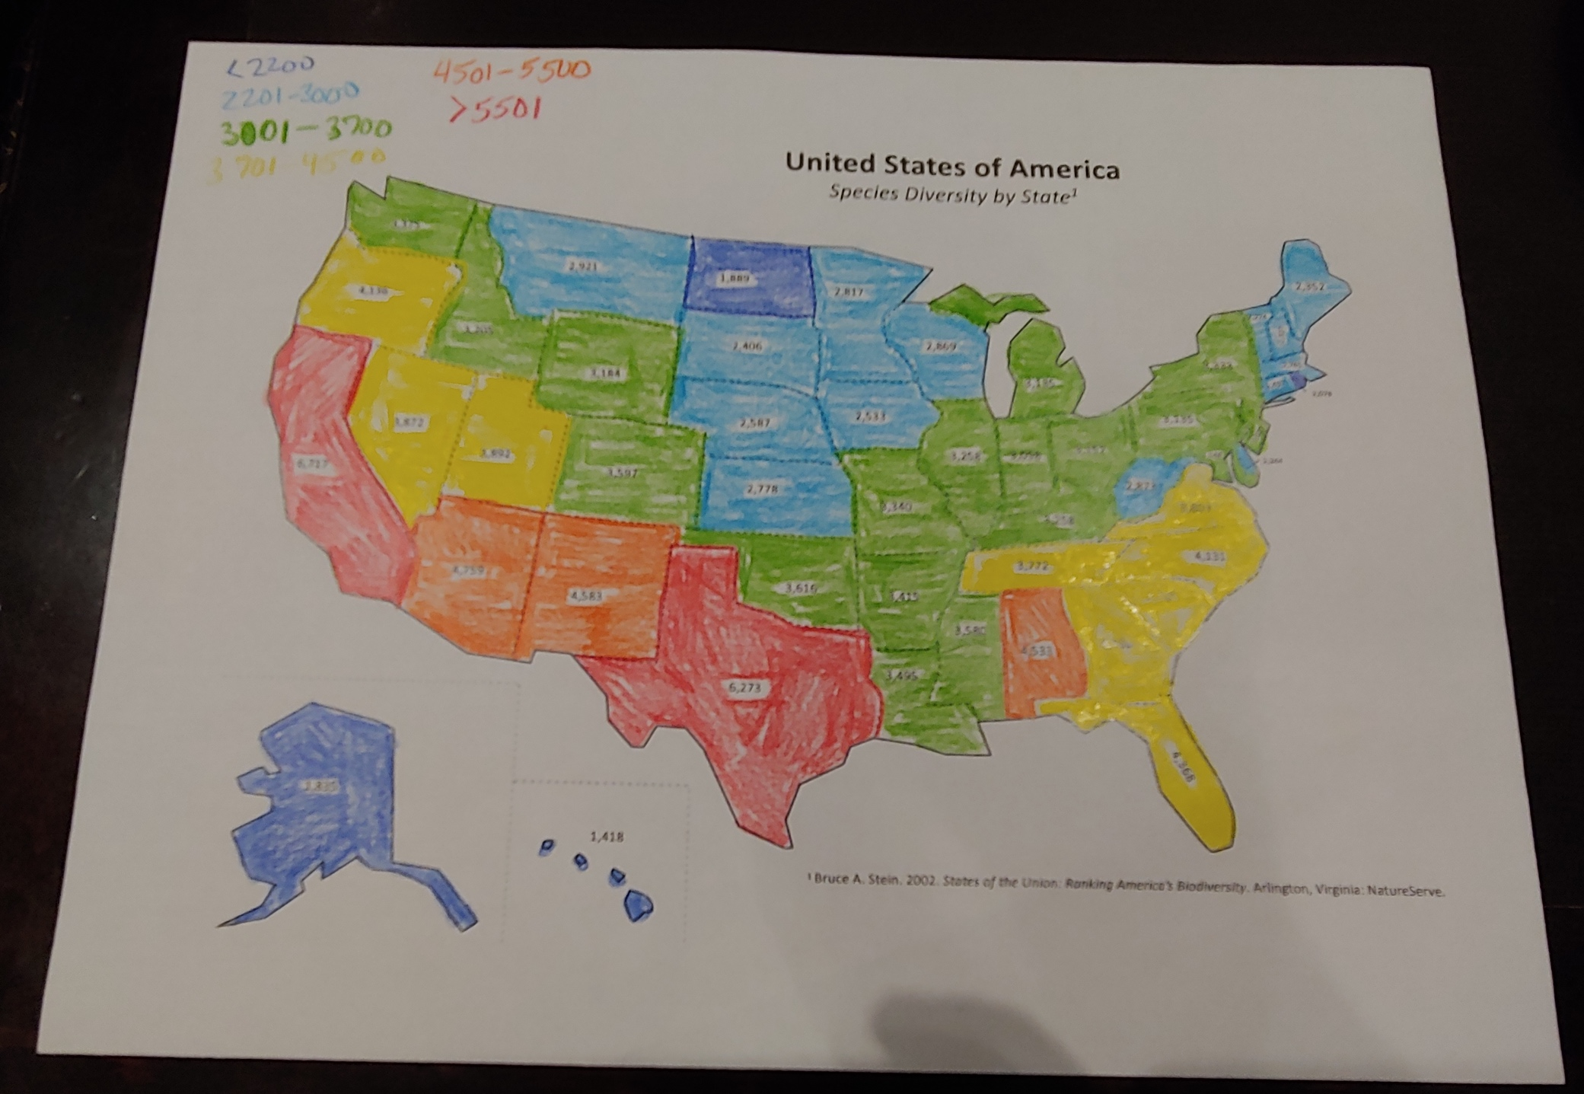

Slide 21
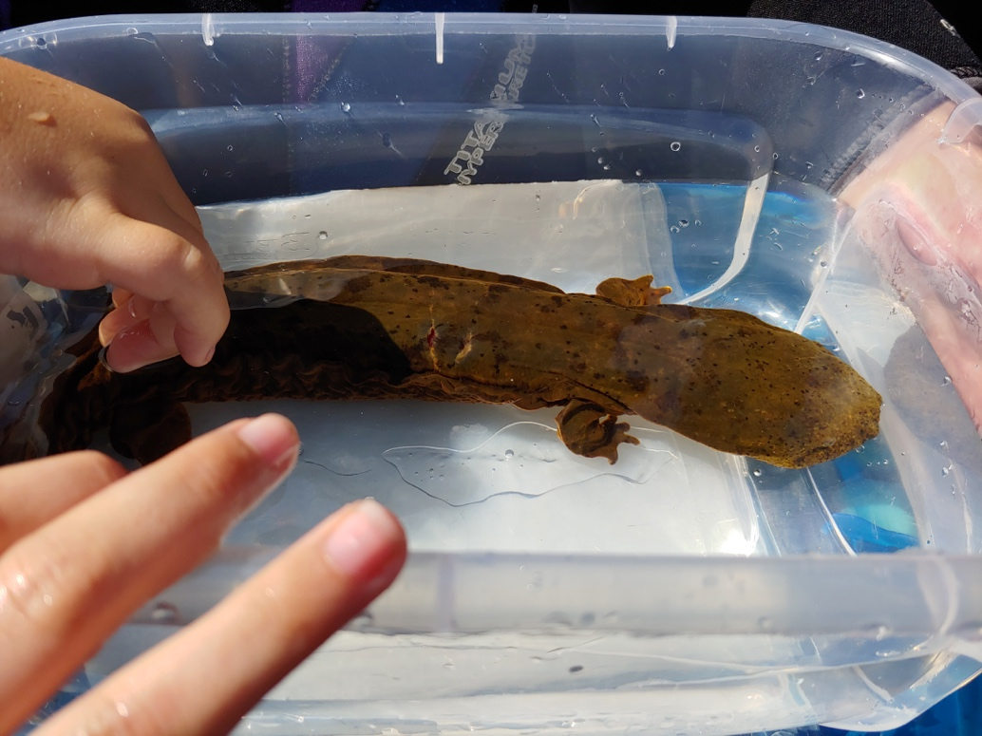
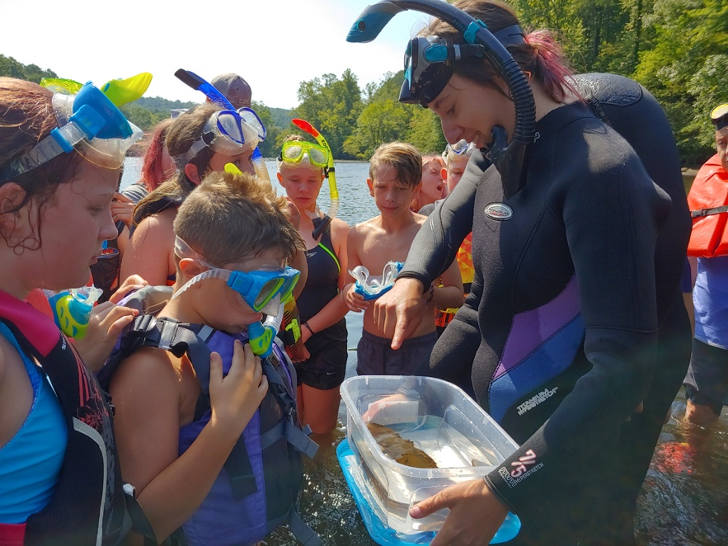
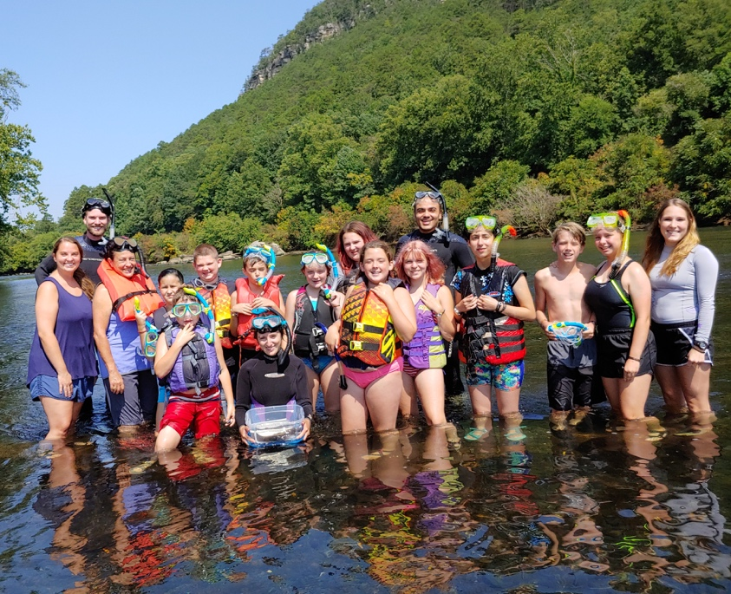
Rank | Diversity | Risk | Plants | Mammals | Birds | Amphibians | Fishes
1 | California | Hawaii | California | California | Texas | North Carolina | Alabama
2 | Texas | California | Texas | Texas | New Mexico | Georgia | Tennessee
3 | Arizona | Nevada | Arizona | New Mexico | Arizona | Virginia | Georgia
4 | New Mexico | Alabama | New Mexico | Oregon | California | Tennessee | Kentucky
5 | Alabama | Utah | Oregon | Arizona | Florida | Texas | Mississippi

Slide 22
